Slide 1
Code Demonstration Software explanation
Team: FIT3161_MA_4
Group Members: Jason, Tah and Ethan

Slide 2
Introduction
Project title
Improving Software Testing
Background
Our main objective is to devise a method which is effective at finding fault proneness of a system module/class with imbalance data.

Slide 3
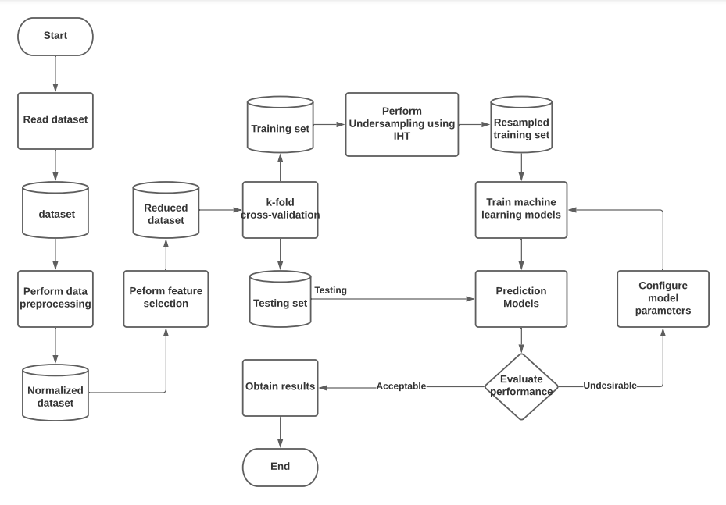
How it was designed: Main algorithm (1/3)
As our objective with this program is for it to handle the issue of data imbalance, the following data handling techniques were included.
List of techniques used:
Missing data handling
Normalisation
Undersampling using IHT techniques
K-fold Cross-validation

Slide 4
How it was designed: Main algorithm (2/3)
We also wanted to give the user the option of selecting which prediction models they wanted to use, therefore we implemented a range of options for them to choose from (as listed below).
List of machine learning models (base)
Multi-Layer Perceptron
Logistic Regression
Naïve Bayes
Complement Naïve Bayes
Decision Tree
List of machine learning models (ensemble)
Rotation Forest
Voting
Random Forest

Slide 5
How it was designed: Main algorithm (3/3)
To further improve the performance of our program, we included some feature selection algorithms to help select the best features for training the prediction models.
List of feature selection methods
Correlation based feature selection
Recursive feature elimination

Slide 6
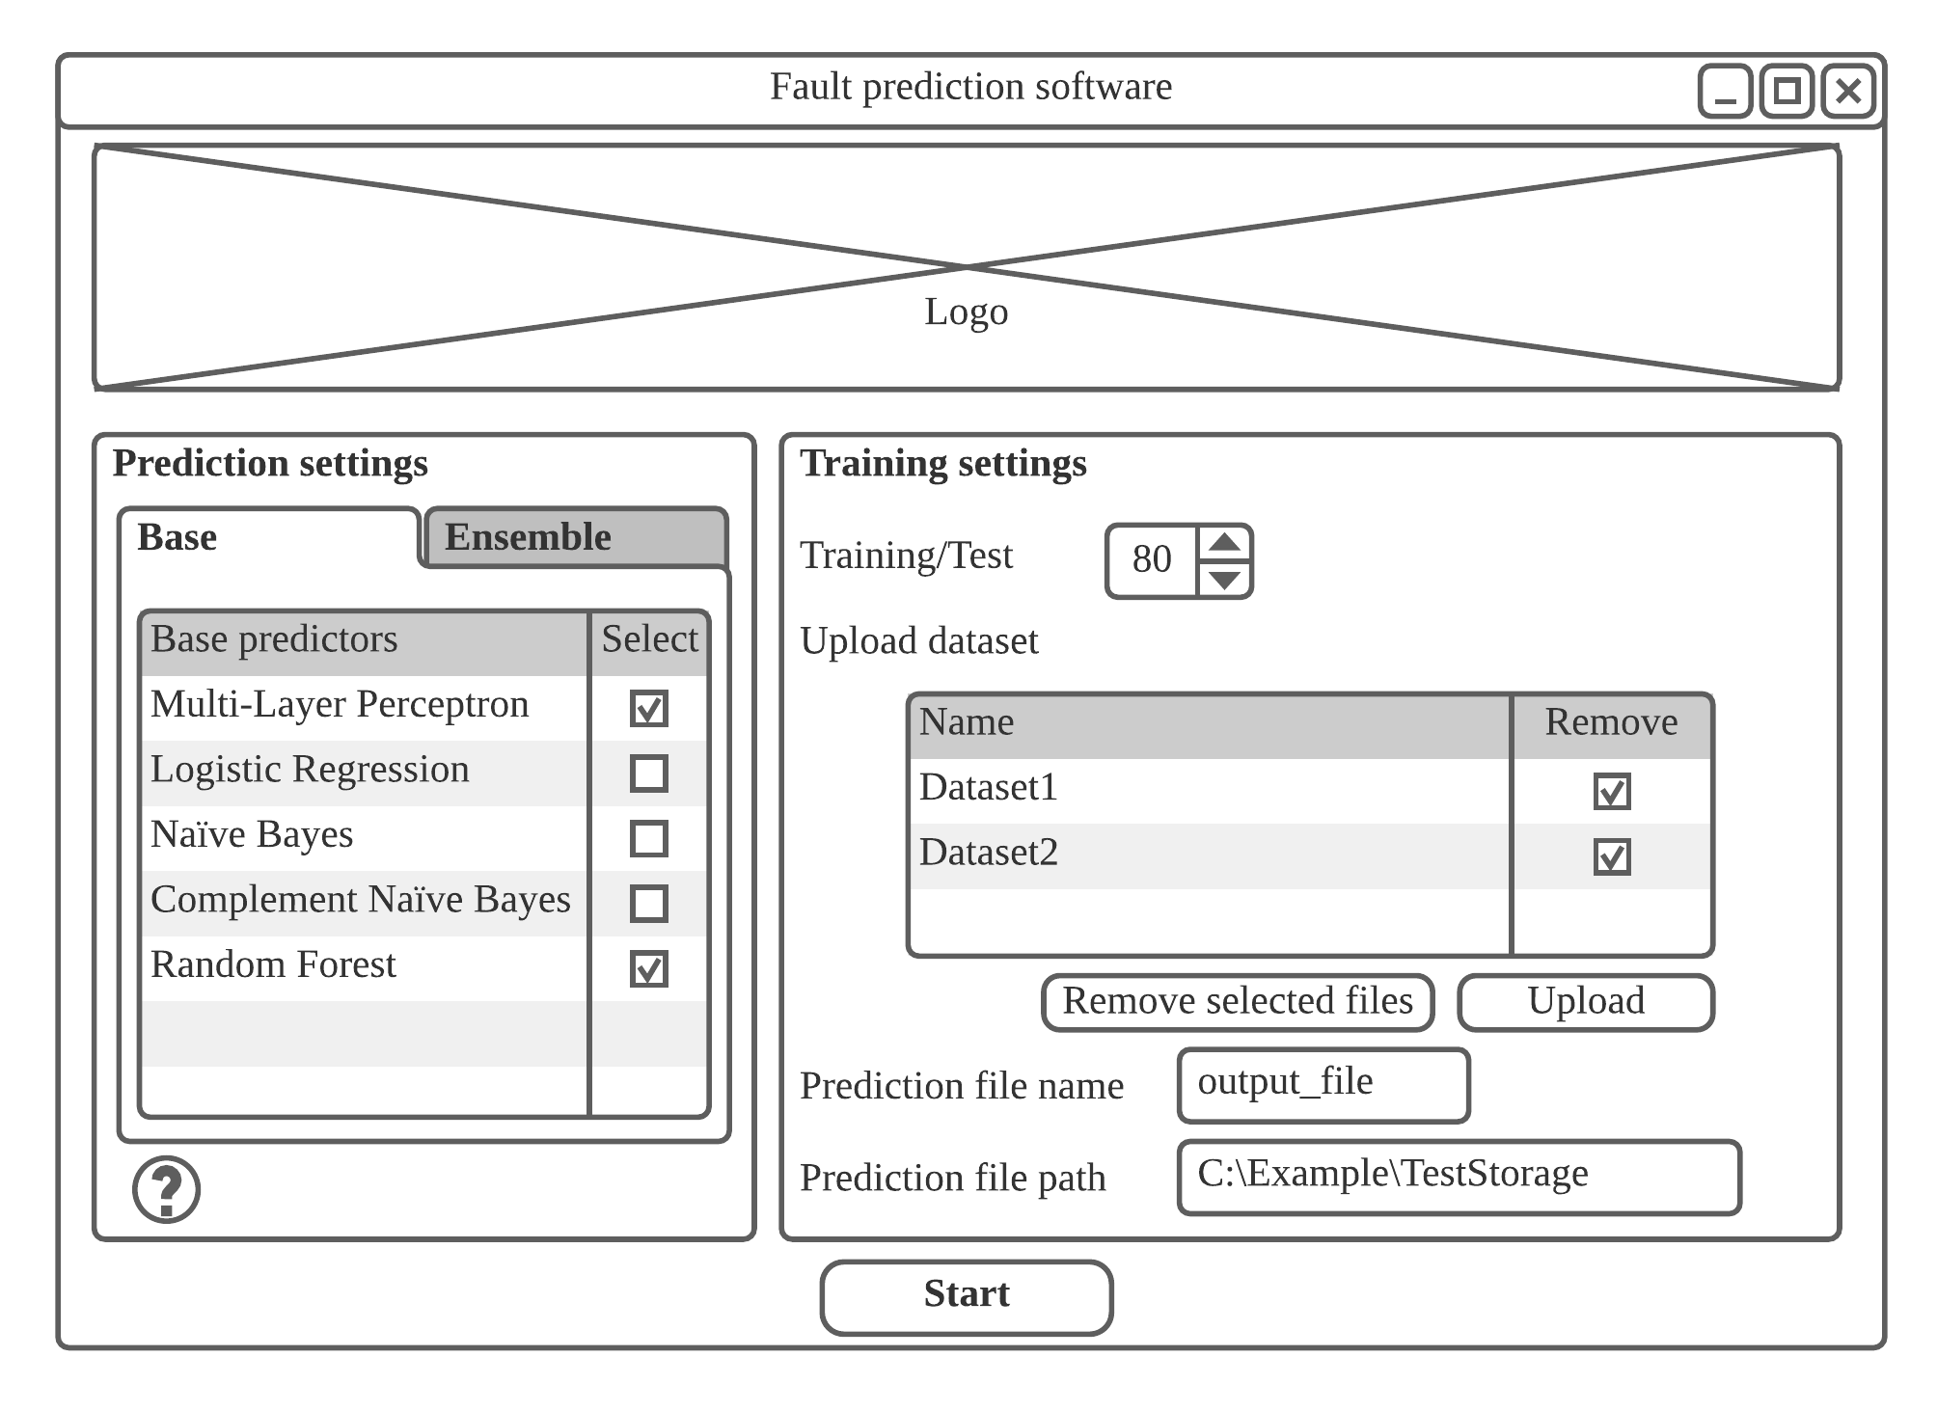
How it was designed: Interface
For our project, we want to implement an interface as well for better usability. So sketches were done to visualize the interface within our program.

Slide 7
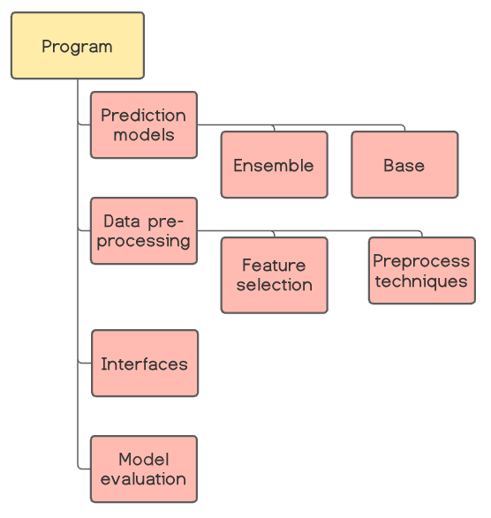
How it was designed: Modules
From implementation, my team took a modular approach where we made individual code files for every technique, interfaces and models. These code files all contain a method which are then imported to the following code files:
Preprocess
Incorporates all the preprocessing techniques to be performed to a given dataset
Main algorithm
Performs all the required computations, produces the csv file and returns the result
Main
Connects the interface and handles the inputs to be passed into the main algorithm

Slide 8
Packages used
Sklearn - Machine Learning Library
Used to build and train models
Tkinter - GUI for Python
Used to build the user interface for our software
Numpy - Mathematical Library
Scipy - Scientific and Technical computing Library
Pandas - Data manipulation and Analysis
Unittest - Testing Library

Slide 9
Platform used
Programming language: Python
Compatible operating systems: Windows, Mac and Linux
Note:
Some files were implemented in Jupyter Notebook as it allowed us to test our models by running code sections

Slide 10
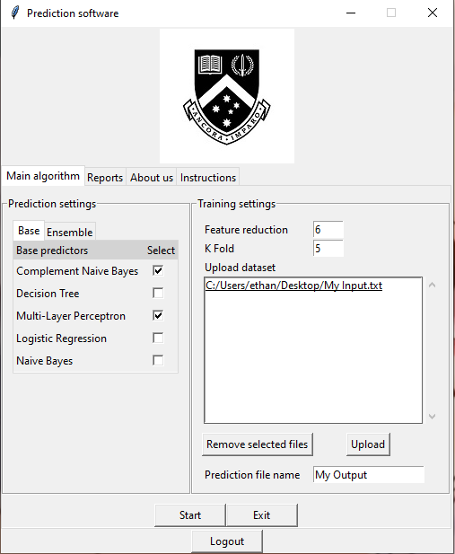
Inputs and Outputs of the program
Input:
User uploads their desired datasets to the program (in .arff or .txt file format)
Then, they can select the predictors they want to use on the dataset
Certain training settings can also be changed in the program (feature reduction and number of K-fold)

Slide 11
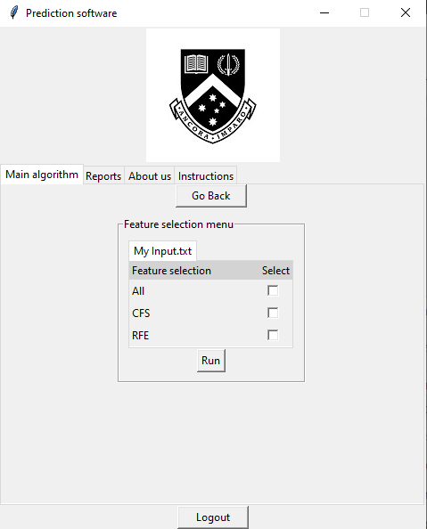
Inputs and Outputs of the program
Input:
Users have the option to include a feature selection algorithm to select the best features for training the model.
Once everything is set, the program is run

Slide 12
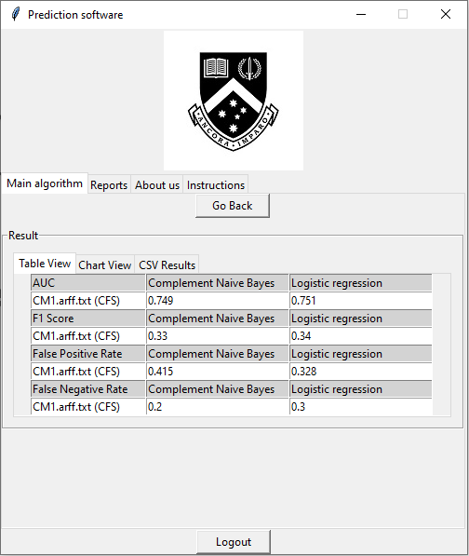
Inputs and Outputs of the program
Output:
Once everything is processed in the background, a table of results is displayed for the user to see.
Results can also be viewed in the form of a chart
A CSV file of the results is also generated in the program’s directory.

Slide 13
Software limitations
Pre-processing cannot be configured
No settings present for configuring this section of the algorithm
Loading screen cannot be implemented
User is required to wait until the program finishes running, without the knowledge of when it finishes
Chart formats are not flexible
Only bar charts are being used
Incapable of accepting datasets of various file types
Currently fixed to .arff and .txt file formats

